Slide 1
COVID IMPACT AROUND THE GLOBE
DATA ENGINEERING CAPSTONE PROJECT BY Hayatu abdullahi

Slide 2

AGENDA
PROBLEM STATEMENT
METHODOLOGY
CODE DEMONSTRATION
VISUALISATION

Slide 3

PROBLEM STATEMENT
OBJECTIVE OF THIS PROJECT: DESIGN A DATA ENGINEERING PIPELINE CAPABLE OF EXTRACTING DATA FROM COVID 19 API/SITE FOR THE PURPOSE OF VISUALISATION
KEY TASKS | TECHNICAL CHALLENGES
DATA EXTRACTION | API INTEGRATION/WEBSCRAPING HARDSHIP
DATA STORAGE & MANIPULATION | SQL CONNECTION
DATA PROCESSING & OPTMISATION | EXTRACT ONLY FRESH DATA

Slide 4




METHODOLOGY

Slide 5
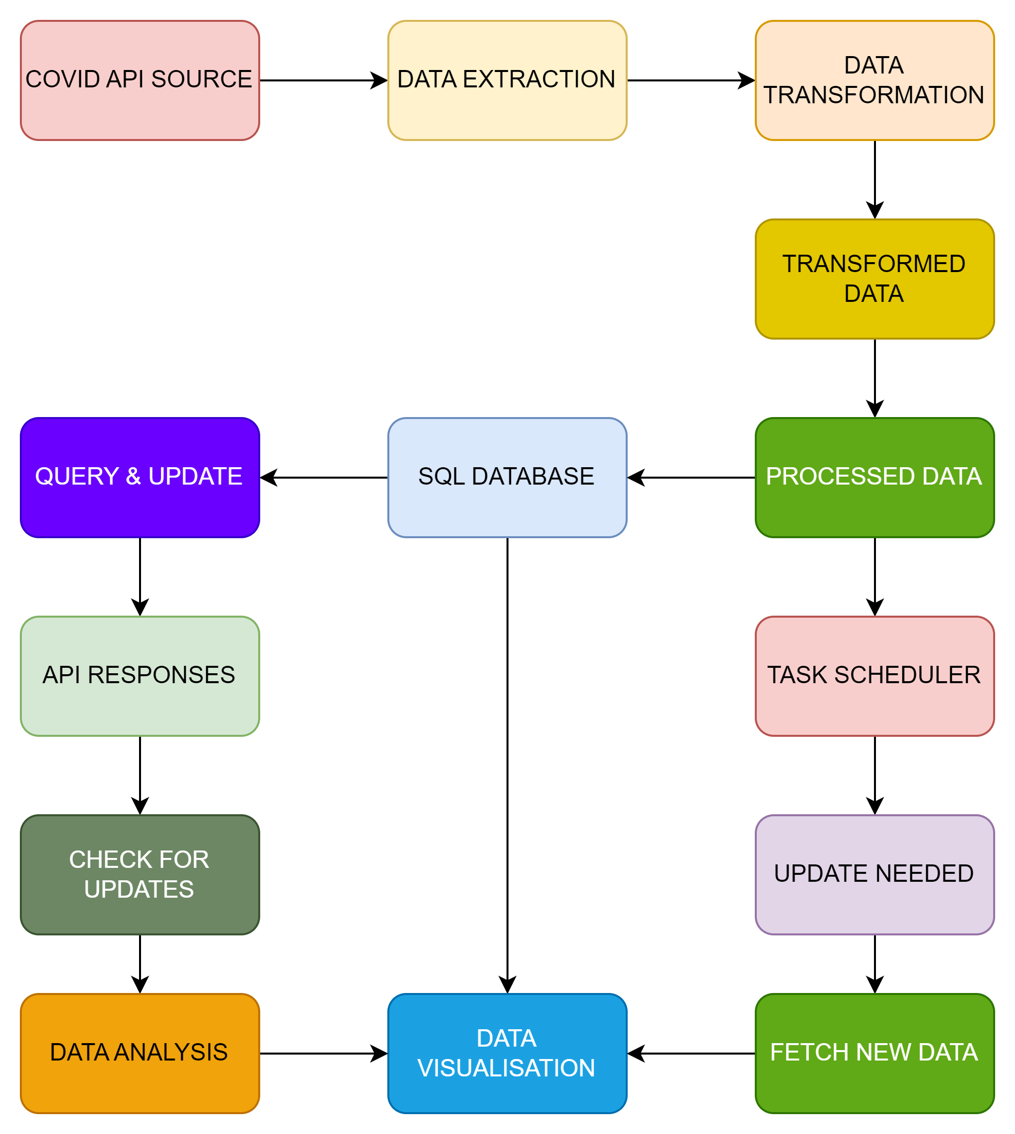





METHODOLOGY

Slide 6
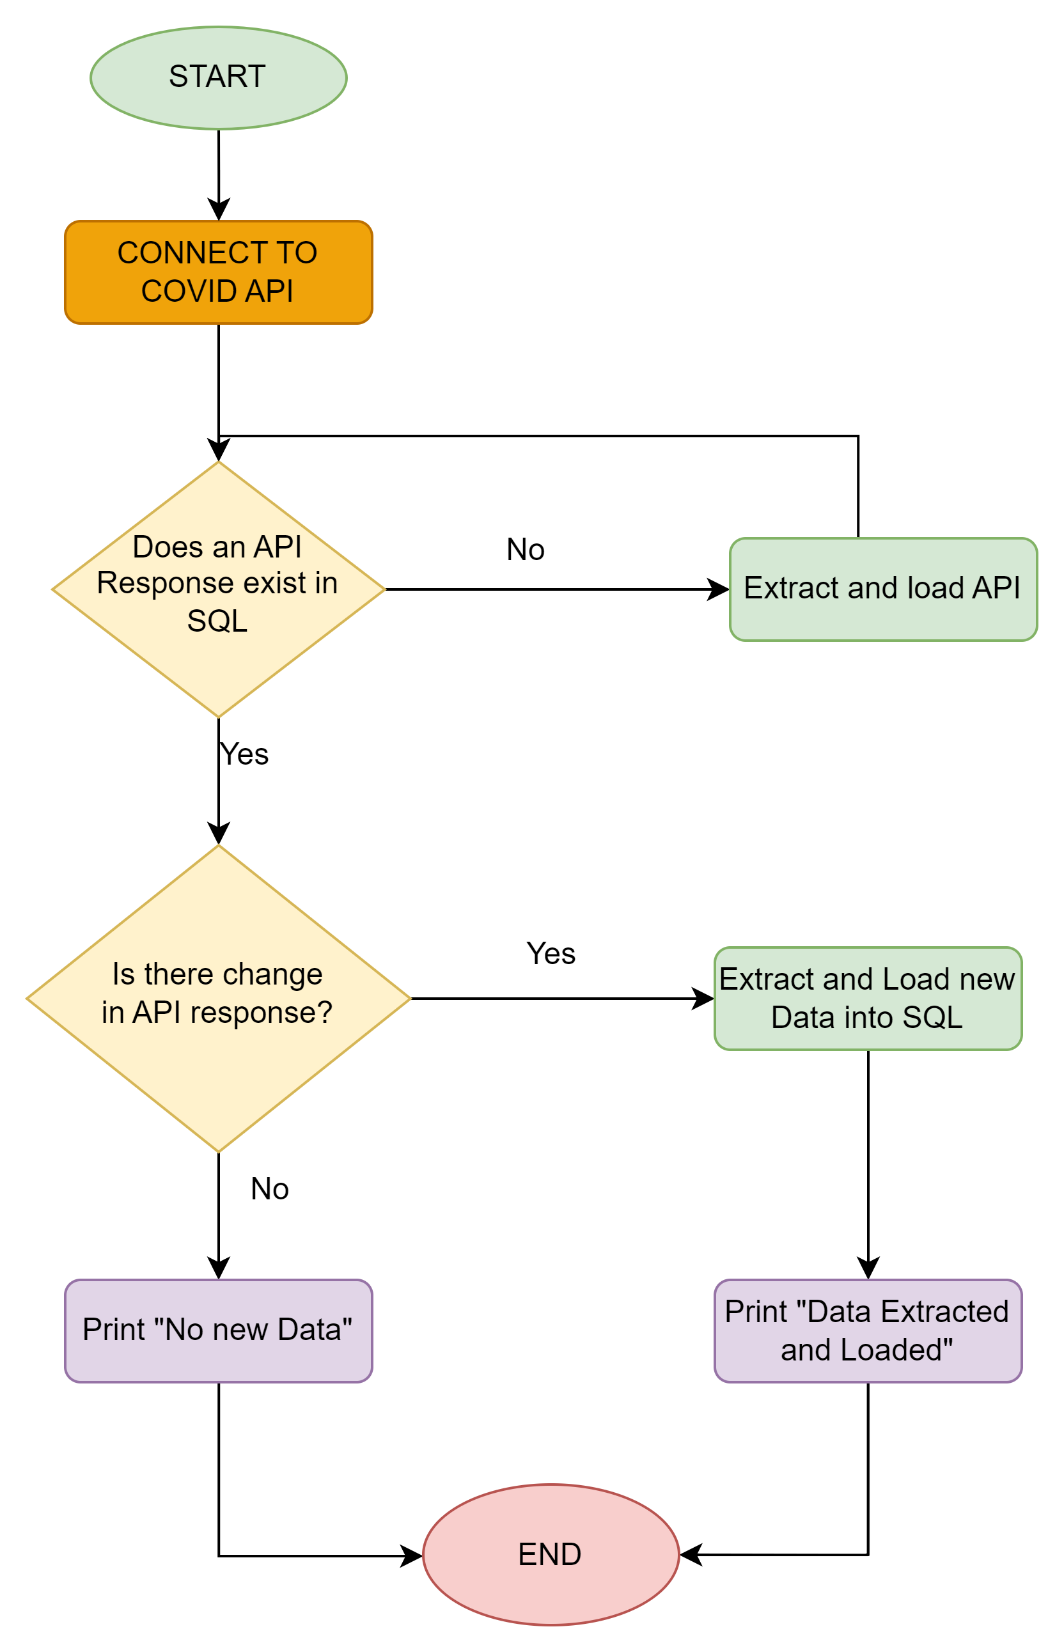



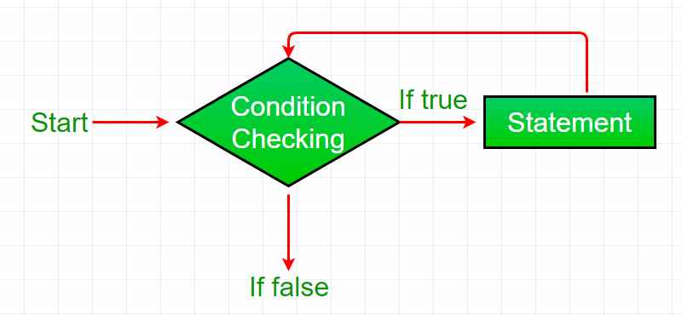
METHODOLOGY

Slide 7

CODE DEMONSTRATION

Slide 8
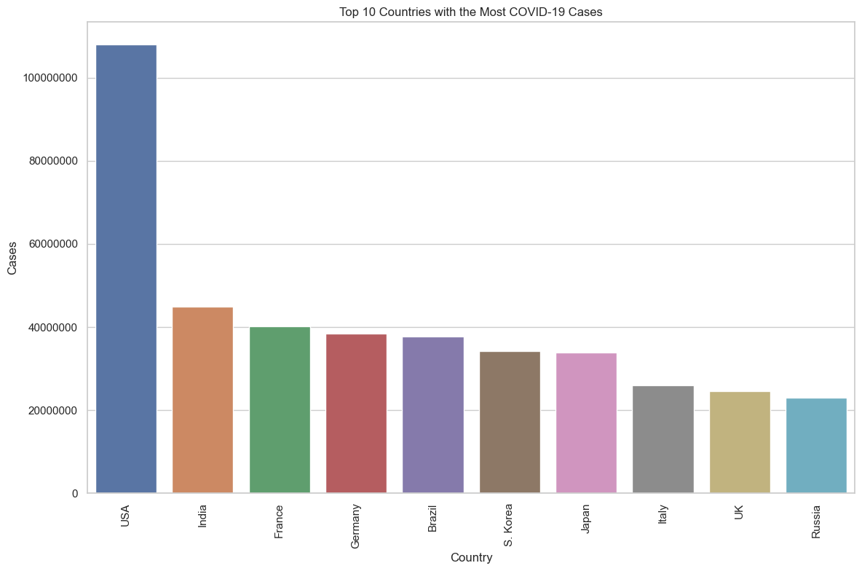
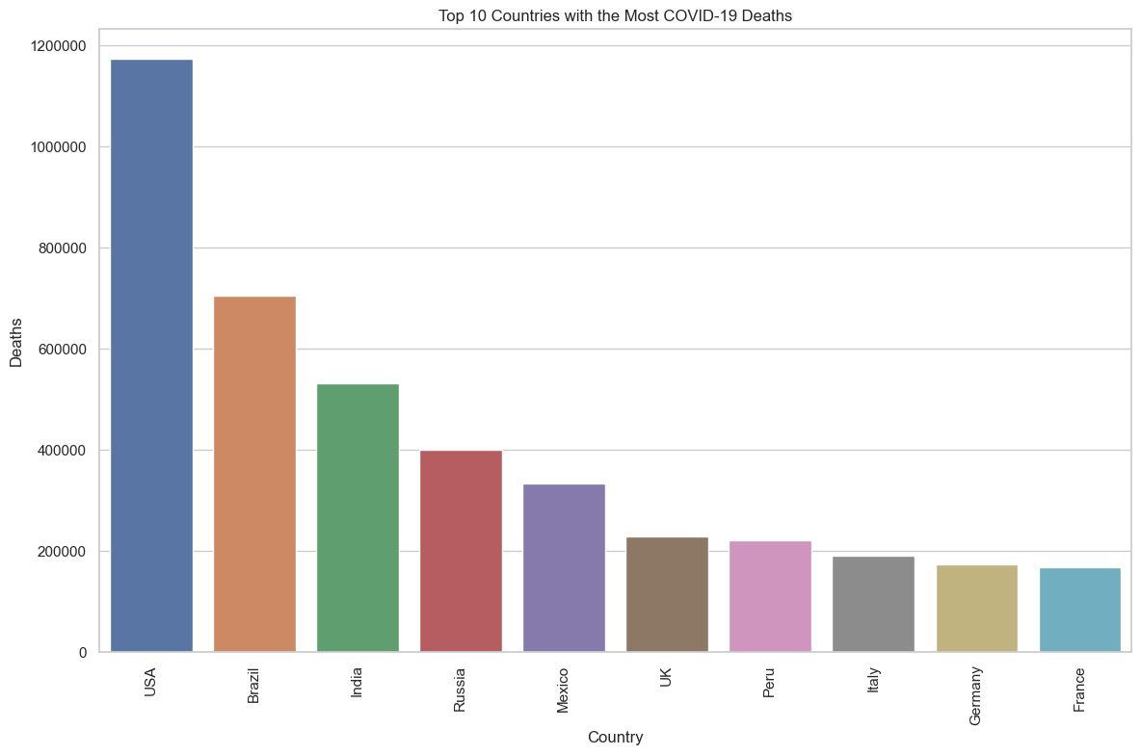
VISUALISATION

Slide 9
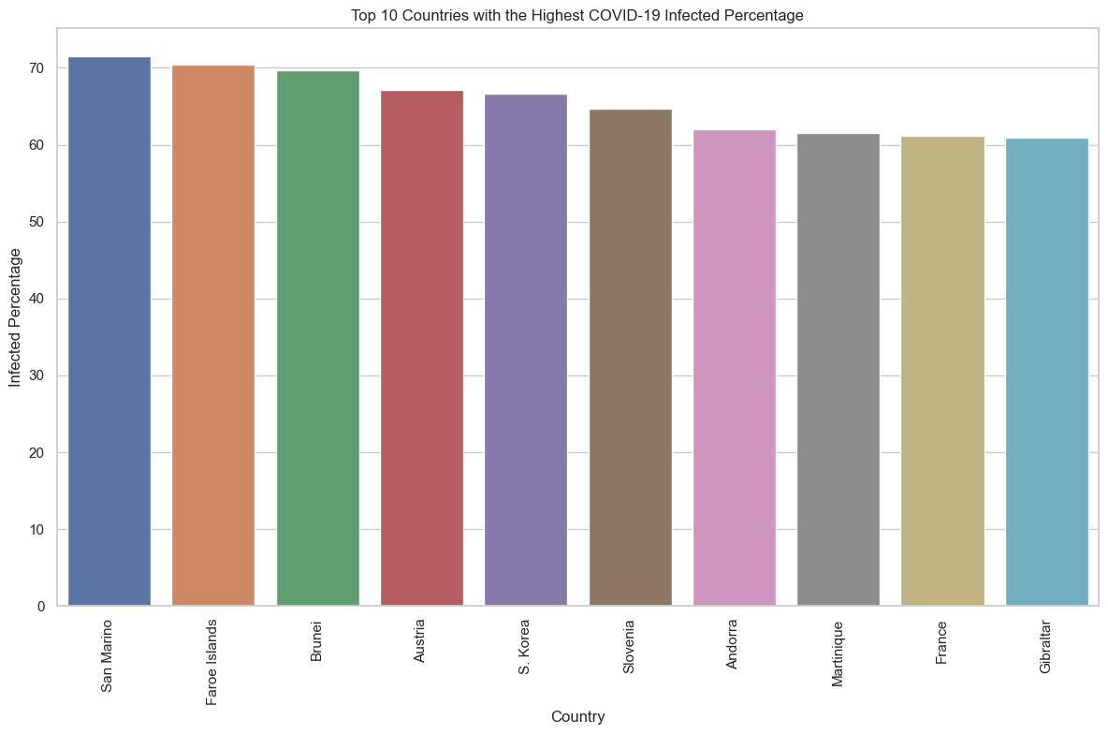
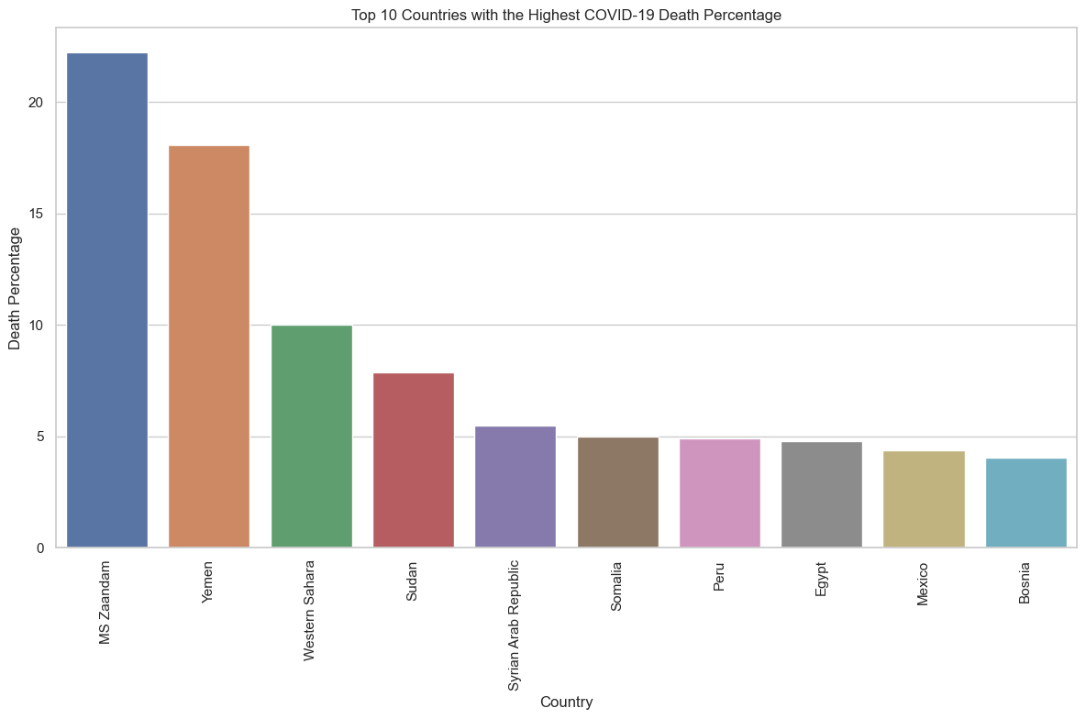
VISUALISATION

Slide 10
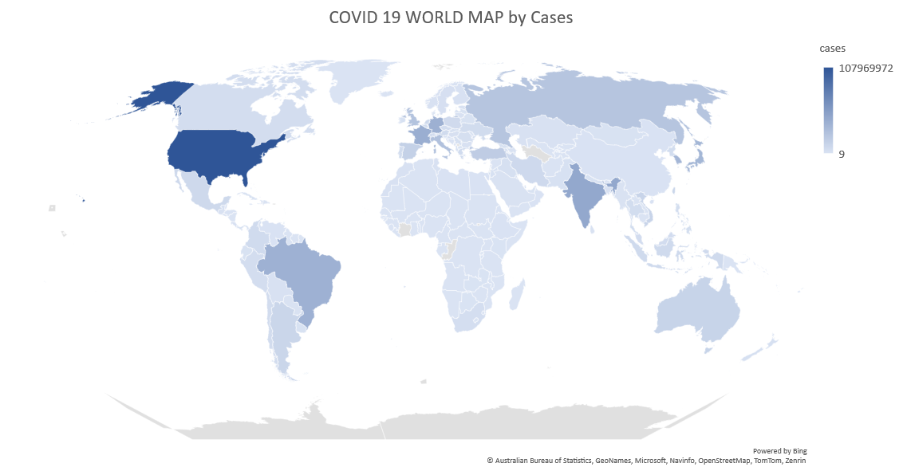
VISUALISATION

